Slide 2
System types

Slide 3
System types
Off-grid No grid available. Use battery as a buffer, buffering solar energy and/or energy coming from a genset.
Bad-grid -> Intentional Islanding Very unreliable and unstable grid. Use a battery and PV, run in inverter mode when possible and only fall back to the grid when necessary. (ignore AC)
Unreliable grid / Marine / Automotive: backup Grid frequently fails: a battery is used to power loads when mains is not available.
Energy storage Use a battery to store excess solar power (day), to later use it when there is not enough solar power available to power the loads (evening and night). Grid is stable, and 99.99% available

Slide 4
ESS Assistant - Perfect for Energy Storage Systems

Slide 5
Base

Slide 6
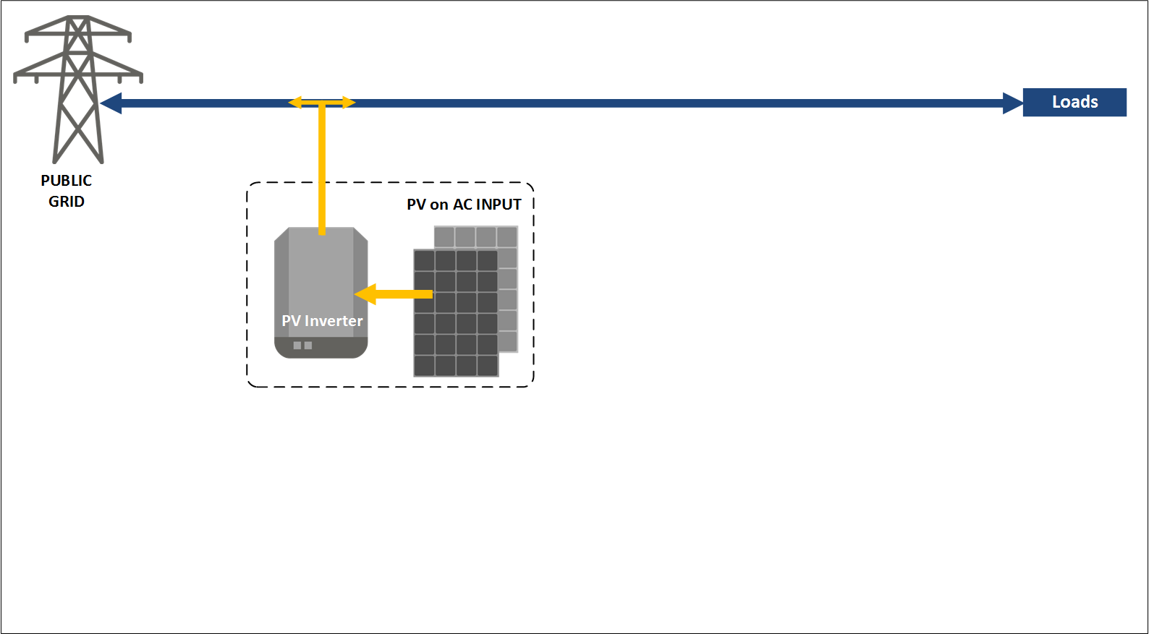
Standard AC-coupled PV

Slide 7
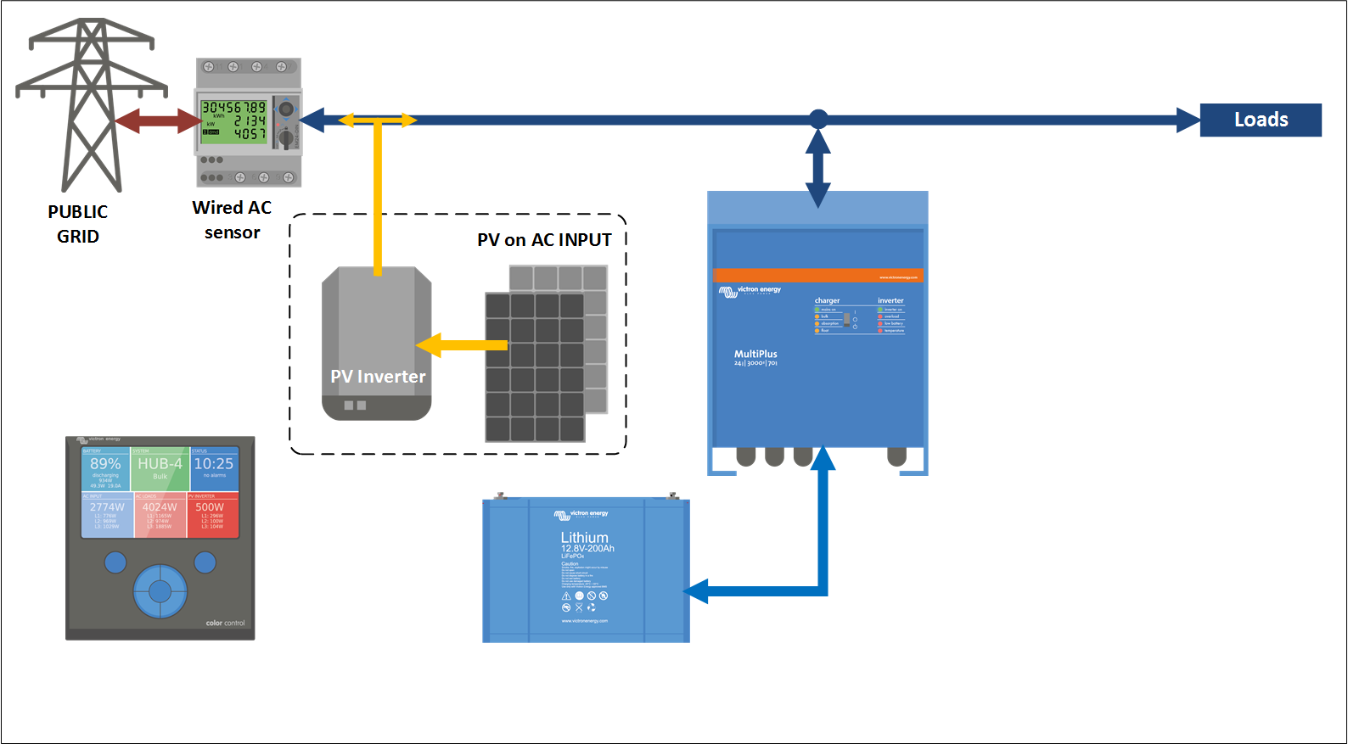
Add the Energy Storage & Meter

Slide 8
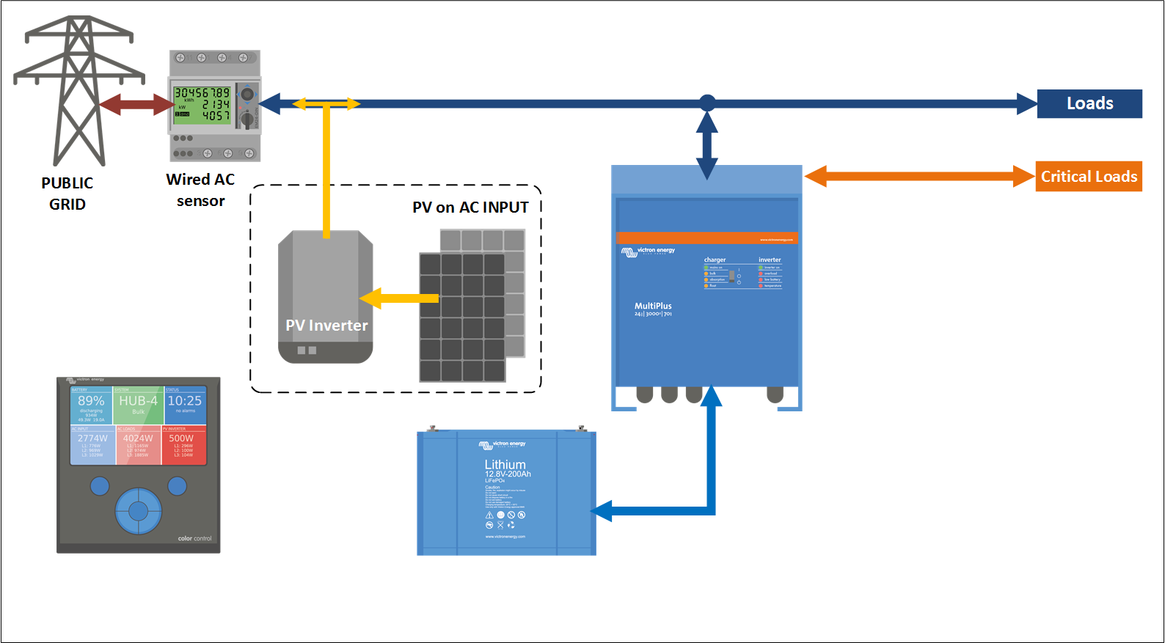
Add critical loads

Slide 9
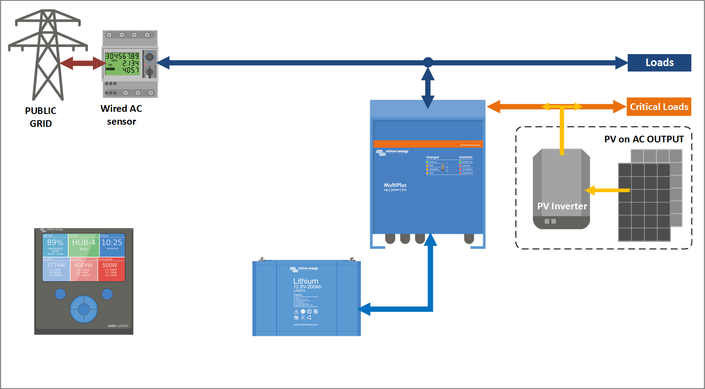
AC-Coupled PV on output

Slide 10
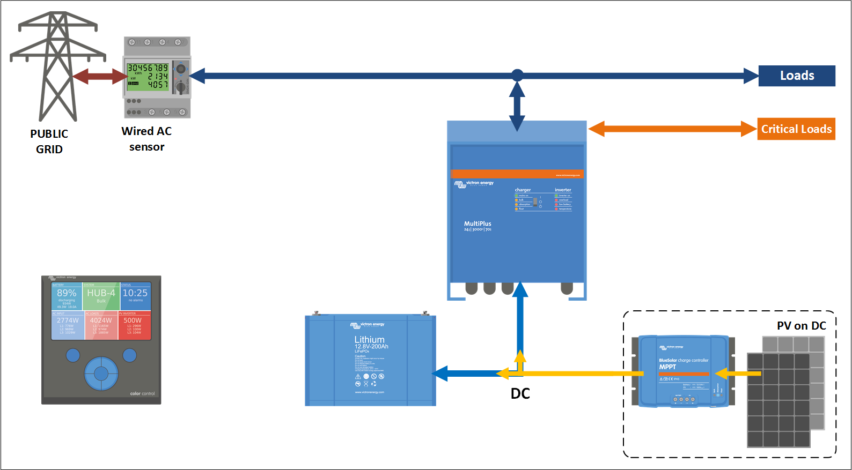
DC-Coupled PV

Slide 11
AC Coupled PV on input

Slide 12
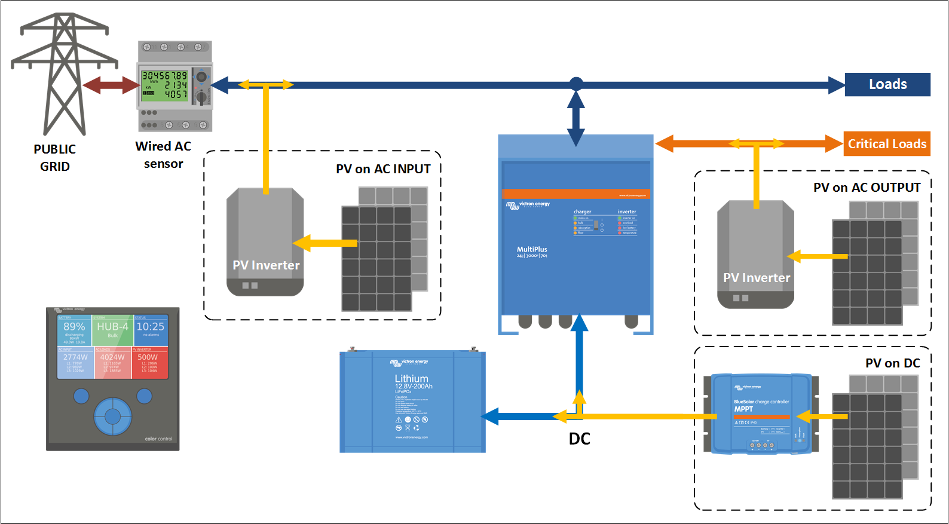
All (or a combination) is also possible

Slide 13
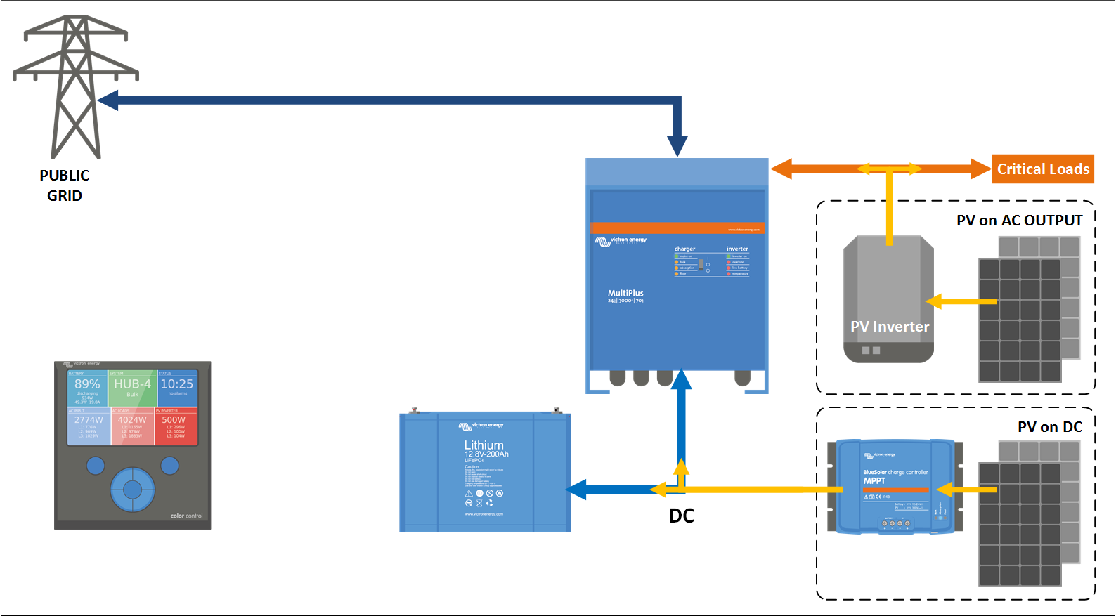
New! ESS Assistant without meter

Slide 14
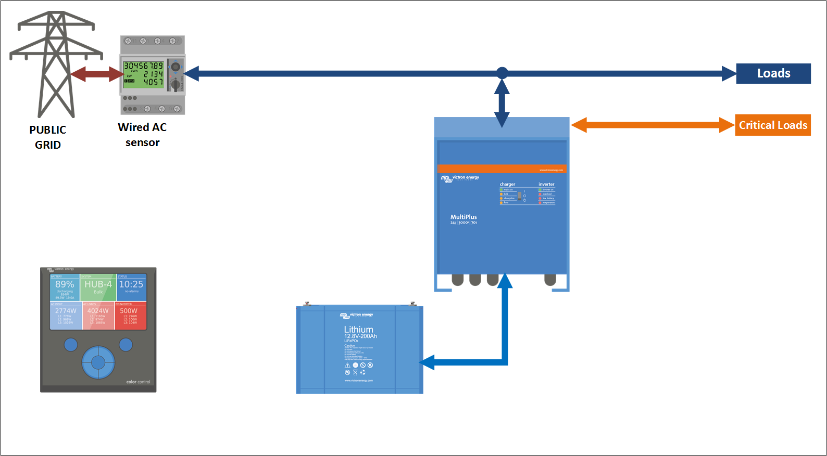
Pure Energy Storage - no PV

Slide 15
BatteryLife
“There is no point in discharging a battery today / tonight, when you already know that it will not be recharged tomorrow.”
Longer battery life for lead & passive balanced Lithium
Be prepared for a mains outage
Mandatory for Victron 12.8V lithium batteries, because they have passive balancing no BatteryLife -> no warranty!

Slide 16
Perfect Energy Storage System
Easy configuration in the CCGX
Compatible with many battery brands
DC-Coupled and/or AC-Coupled PV
Enable/disable feed-in
Zero feed-in for Fronius PV Inv.

Slide 17
ESS Details

Slide 18
What about the Hubs?
Hub-1: deprecated except for policy 3: Invert priority
Hub-2: deprecated except for policy 2: Invert priority
Hub-4: deprecated entirely
What does deprecated mean? It means no support. In case of problems, first update to ESS, and then contact us again in case of trouble.

Slide 19
No feed-in systems
Use an MPPT, do not use a PV Inverter
Still want to use a PV Inverter? Then at least take a Fronius. (and use Zero Feed-in)
Remember: to prevent feed-in for a PV Inverter, you need to sabotage it. Leads to flickering, overloads, and more problems.

Slide 20
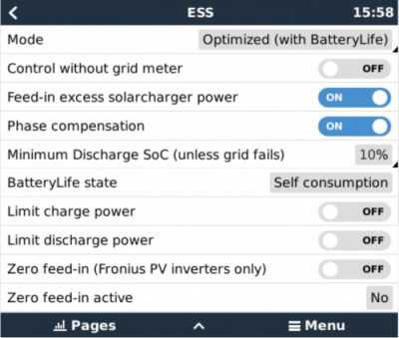
ESS Menu

